Slide 1
Intro to Python
Lesson 1
By Josh schertz

Slide 2
Course Objectives
Learn basic computer science concepts
Able to write simple Python scripts
Experience full application development cycle
Know where to get programming help and learn new concepts
Develop technical problem solving skill set

Slide 3
My Background
Josh Schertz
BBA Finance; BBA Accounting – UTSA ’14
Self taught myself Python starting Jan 2014
Worked 2 years at Valero Energy on transfer pricing system (’13 – ’15)
Cofounded an algorithmic trading company (’16 – present)
Knowledgeable in:
Database systems
Web scrapers
Machine learning
Linux server administration
Web development
Modern financial markets

Slide 4
What is Computer Science?
The study of problems, the problem-solving process, algorithms and abstraction
Goal of developing algorithms
A step-by-step list of instructions for solving any problem
Algorithms are solutions
Abstraction allows us to view the problem and solution in such a way as to separate the logical and physical perspectives
We don’t necessarily need to know how the system works, but we do know how to use the system

Slide 5
What is Programming?
A way to tell a computer what to do
The process of converting an algorithm into a notation (programming language) that can be executed by a computer
A program needs to be a very precise set of steps
Removes ambiguity of natural language while also being concise and formal
Billions of instructions can be executed per second
Programming languages:
Python
C++
C#
SQL
Java/JavaScript
PHP
Go
R
HTML/CSS

Slide 6

Python
High-level, general-purpose and dynamic programming language
Supports object oriented programming (OOP) and functional programming
Released by Guido Rossum in February 20, 1991
Named in honor of British comedy group Monty Python
Cross platform support (Windows, Mac, Linux)
.py files extension
Current versions: 2.7 and 3.5
https://www.python.org/

Slide 7
Installing Python
https://www.python.org/downloads/
Download Python 3.5.2 for your OS
Run the installer
Deselect “Install launcher for all users” then click “Install”
Mac and Linux include Python by default, although it might be 2.7 instead of 3.5 (or 3.4)

Slide 8
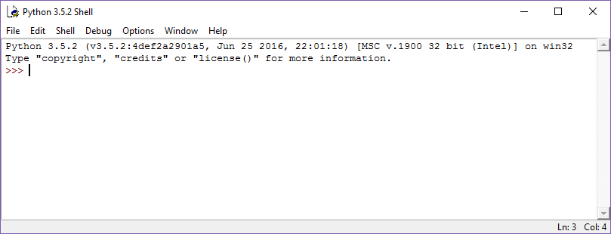
IDLE
An integrated development environment (IDE) for Python
IDEs provide an single program in which all development is done
Includes Shell (interactive) and File (savable code)

Slide 9
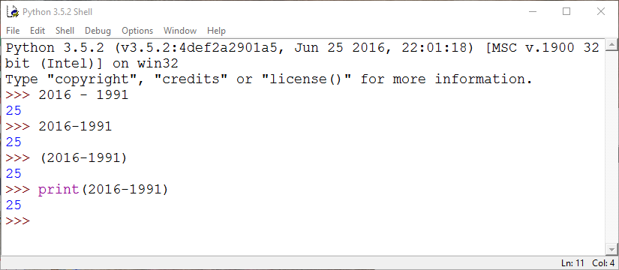
Python’s age?
How many years has Python been active since it appeared in February 1991?

Slide 10
Data Types
String (str) – text enclosed within single, double or triple quotes (‘frogs’)
Integer (int) – positive/negative whole numbers (1, 2, 3, 4, -1, -2)
Float – real numbers with a decimal point (3.14, 3+e18)
Boolean – True or False object
List – stores items separated by commas, enclosed within square brackets; can be updated
Tuple – stores items separated by commas, enclosed within parentheses; cannot be updated
Dictionary – stores multiple key/value pairs within curly braces

Slide 11
Mathematical Operations
Operation | Meaning | Example
+ | Addition | 1 + 2 = 3
- | Subtraction | 2 – 1 = 1
/ | Division | 4 / 2 = 2
* | Multiplication | 2 * 2 = 4

Slide 12
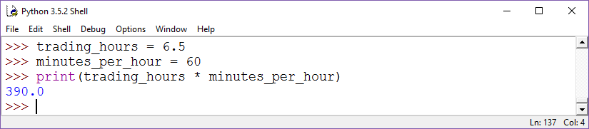
Trading Minutes
How many minutes are there in a normal 6.5 hour trading day?
Variable assignment
Float output from float times int

Slide 13
Special Mathematical Operations
Operation | Meaning | Example
/ | Division | 5 / 2 = 2.5
// | Floor Division | 5 // 2 = 2
% | Modulo – yields the remainder from the division of the argument | 5 % 2 = 1

Slide 14
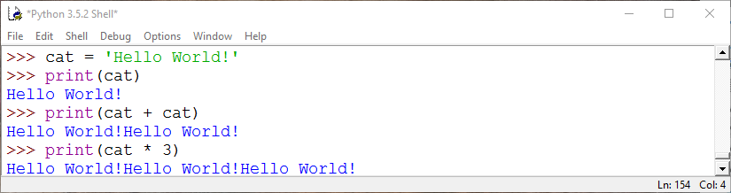
Strings
A contiguous set of characters represented within quotation marks
Multiple strings can be concatenated with addition sign (+)
A single string can be duplicated n times by multiplying the string by a integer using the asterisk (*) sign

Slide 15
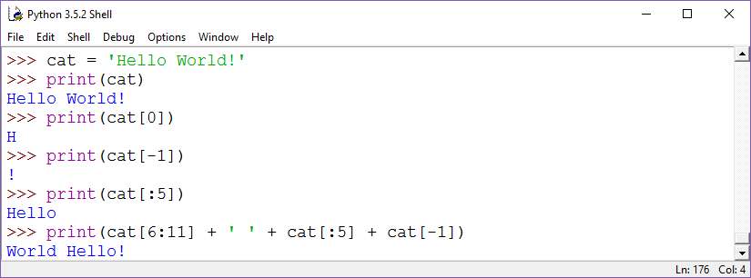
String Indexing
Subsets of strings can be taken using the slice operator (square brackets)
Index starts at 0 in the beginning of the string
-1 will return the last item in the string

Slide 16
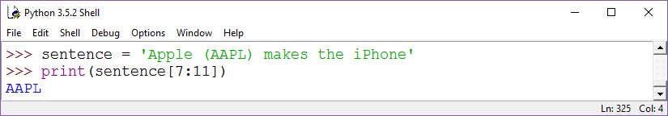
String Indexing Example
Write an expression for returning the ticker from this sentence:
“Apple (AAPL) makes the iPhone”

Slide 17
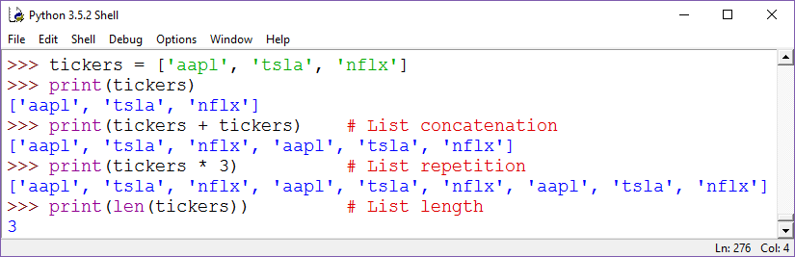
Lists
A list contains items separated by commas, enclosed within square brackets
Each item can be a different data type from its neighbor

Slide 18
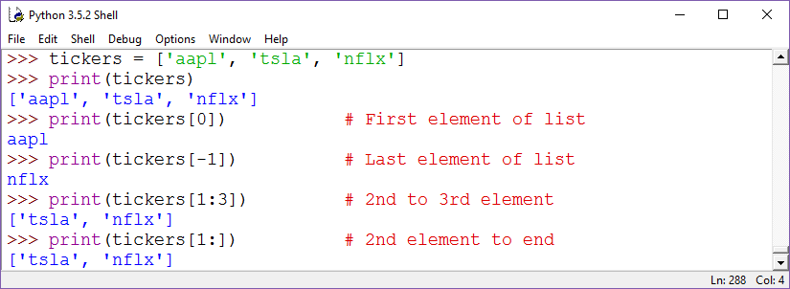
List Indexing
Items can be accessed using the slice operator (square brackets)

Slide 19
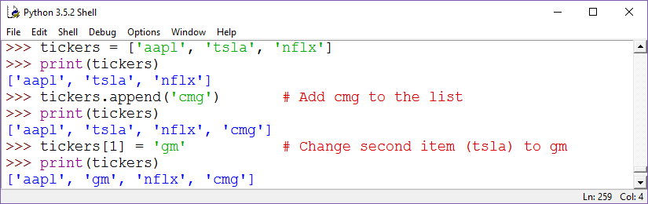
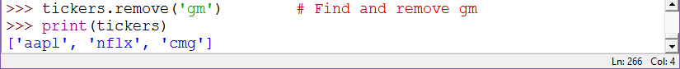
List Manipulations
Items can be added, updated or removed from existing lists
Lists are mutable

Slide 20
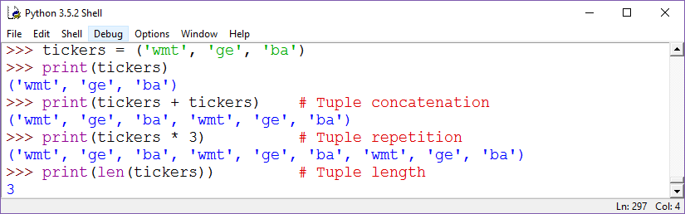
Tuples
A tuple is similar to a list, where it contains items separated by commas, enclosed within parentheses
Tuples cannot be updated (immutable)
Each item can be a different data type from its neighbor

Slide 21
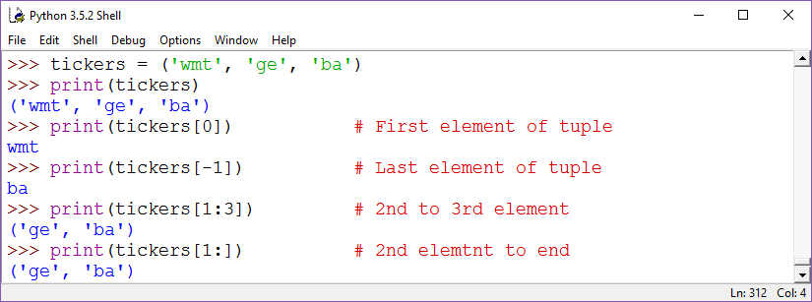
Tuple Indexing
Items can be accessed using the slice operator (square brackets)

Slide 22
Tuple Manipulations
Items cannot be added, updated or removed from existing tuples
Tuples are immutable
So why use tuples?
Faster than lists
Safer than a list for data that doesn’t need to change (write protected)

Slide 23
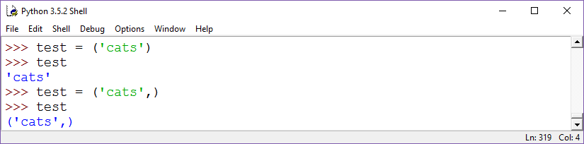
Single Item Tuples
Tuples with a single item require a comma after the item is specified
Otherwise, the tuple object is converted to the item’s default type

Slide 24
Data Comparisons
Operation; | Meaning | Example
< | Strictly less than | 0 < 1 = True
<= | Less than or equal | 0 <= 0 = True
> | Strictly greater than | 1 > 0 = True
>= | Greater than or equal | 1 >= 1 = True
== | Equal | 2 == 2 = True
!= | Not equal | 1 != 2 = True
is [not] | Object identity; [is not] | 1 is int = True
[not] in | Object identity; [not in] | 1 in [1, 2, 3] = True

Slide 25
Boolean Operations
Operation | Alternative Symbol | Meaning
x or y | | | If x or y is True, then True
x and y | & | If x and y are True, then True

Slide 26
Python Syntax
Blocks of code are denoted by line indentation (4 spaces or 1 tab)
Single (‘), double (“) and triple (‘’’ or “””) quotes are accepted to denote string literals, as long as the same quote starts and ends the string
Hash sign (#) begins a comment (outside a string literal)
Blank lines are ignored (useful for organization)

Slide 27
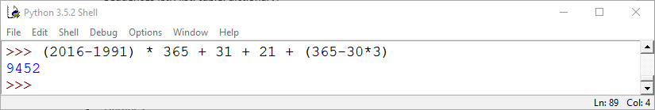
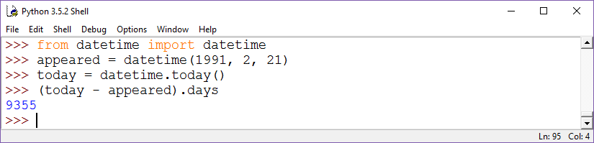
Python’s Age in Days
How many days has Python been active since it appeared on February 21, 1991?
Import from a library
Retrieve item from object

Slide 28
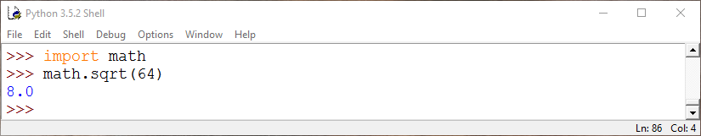
Python Libraries
Python utilizes “Libraries” for accessing modules that others have created within your code
Libraries cover every area from advanced math functions to image processing to date handling
Instead of writing the formula for deriving the square root, just use the “math” library:

Slide 29
Python Standard Library
Python includes standard libraries when installed
Modules provide standardized solutions to many everyday problems
Extensive packages include libraries for accessing file structure, date processing, data compression, multi-processing and other developmental tools
https://docs.python.org/3/library/

Slide 30
3rd Party Libraries
3rd party libraries allow massive expandability in the scope of Python
Any developer can create their own library to share with others
pip is a package management system for installing and managing Python libraries
Finance relevant 3rd party libraries:
pandas – data structure and data analysis
matplotlib – 2D and 3D plotting
SciPy – suite of scientific, mathematical and engineering tools
NumPy – mathematical tools and multi-dimensional arrays

Slide 31
Future Projects
Extract and analyze S&P 500 companies from Wikipedia
Download a stock’s historical daily prices from Yahoo Finance
Make charts from a stock’s historical daily prices
Calculate and add technical indicators to chart
Build stock performance report
??

Slide 32
Sources
https://www.tutorialspoint.com/python/
http://interactivepython.org/runestone/static/pythonds/index.html
https://classroom.udacity.com/courses/cs101
http://docs.python-guide.org/en/latest
http://chimera.labs.oreilly.com/books/1230000000393
http://pythoncentral.io
http://www.programiz.com/python-programming

